Slide 1
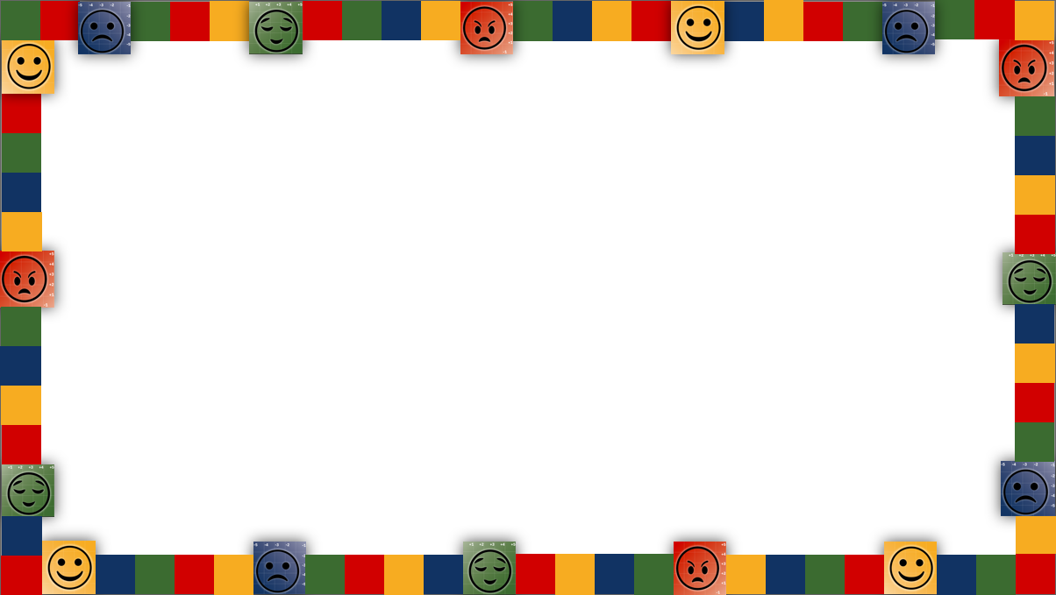


101: Emotional Intelligence Skills & Anchor Tools
NHO EPS Learns | August 22, 2024

Slide 2

Intended Outcomes
By end of this session,
You will gain an understanding of:
  Emotions Matter Mindset
  RULER Skills
  Anchor Tools
You will be better equipped to:
  Contribute to an environment that will help students…

Slide 3

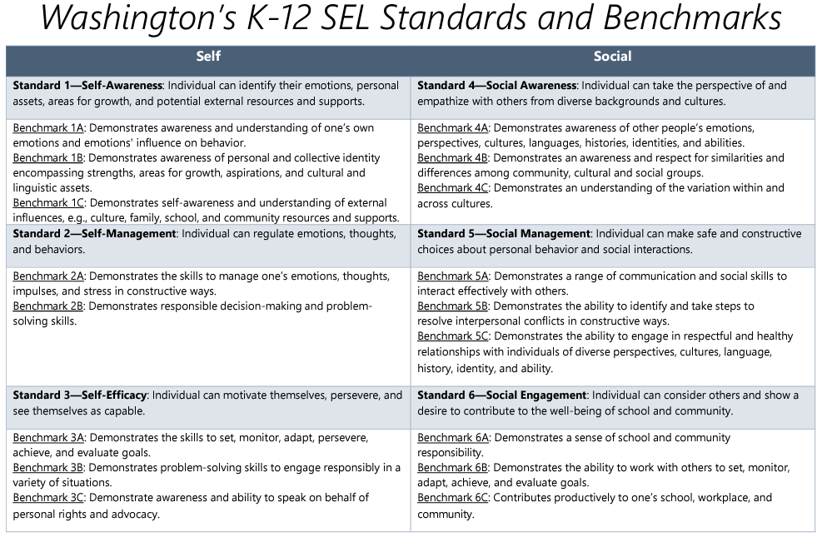
SEL Standards

Slide 4
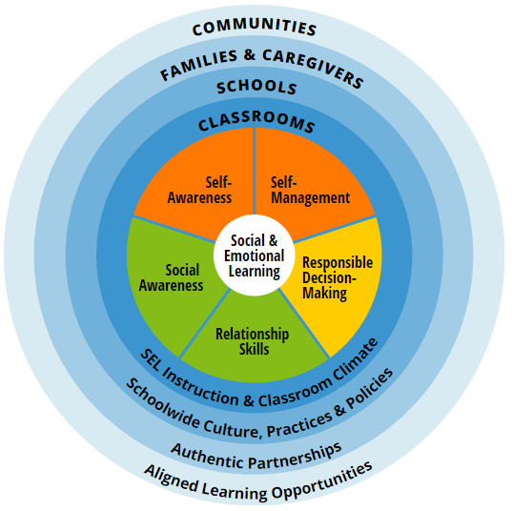

SEL Standards

Slide 5
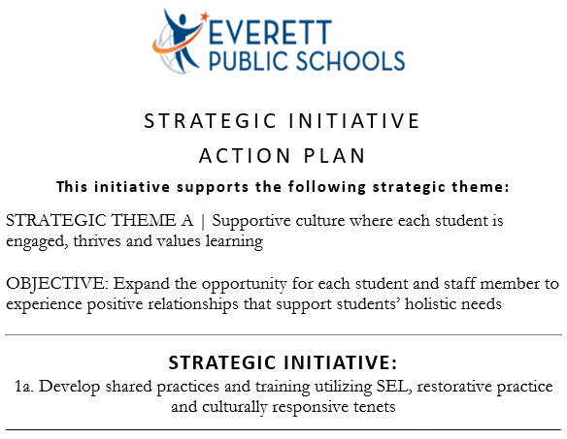
EPS Strategic Plan

Slide 6

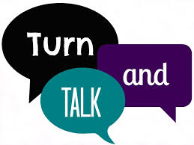
Emotions Matter Mindset
How have your emotions influenced your performance or relationships at work
(positively or negatively)?
Take 30 seconds to think of an example
… then…
Share briefly with those in your breakout group if/as you feel comfortable

Slide 7
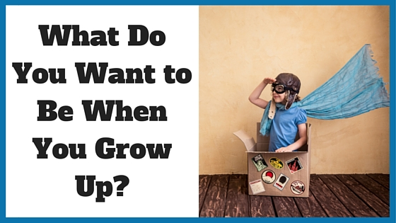
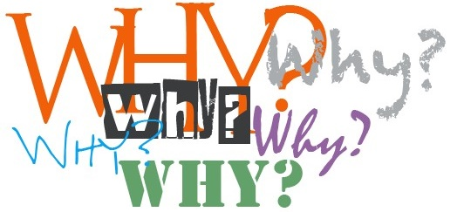
Emotions Matter Mindset
After they answer, ask layers of...
...and you’ll likely drill down to an emotion-based goal or aspiration

Slide 8
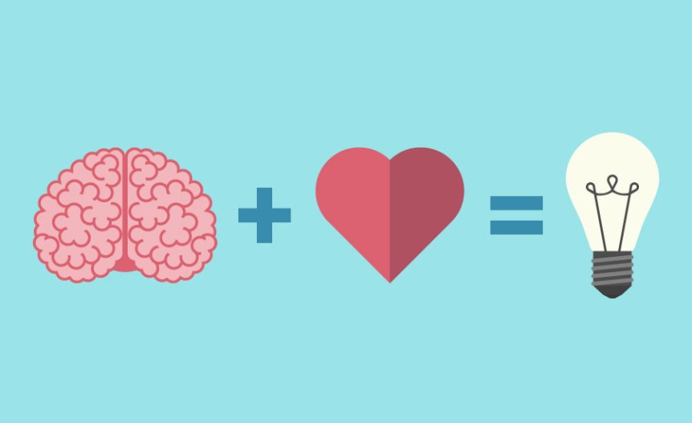
What do Emotions Impact?
Social Interactions
Memory Formation
Creativity
Performance
Motivation
Attention
Engagement
Relationships
Physical & Mental Health
Decision Making
Critical Thinking
Interest
Focus

Slide 9

Why an Emotional Intelligence Emphasis?
Educators and leaders with higher emotional intelligence:
Demonstrate more empathy and greater sensitivity to others’ needs
Develop higher performing teams and build a warmer and more supportive emotional school climate
Receive higher performance
ratings and experience less
stress and burnout

Slide 10

Why an Emotional Intelligence Emphasis?
Students who are skilled in emotional intelligence:
Experience fewer problems with attention, hyperactivity, substance abuse, anxiety, and depression
Engage less in aggressive or socially deviant behavior
Achieve more academically, and experience better relationships, more satisfaction with school, and better wellbeing overall
Participate frequently in classroom
activities, cope in healthier ways
with stress, and behave in more
empathic and prosocial ways

Slide 11
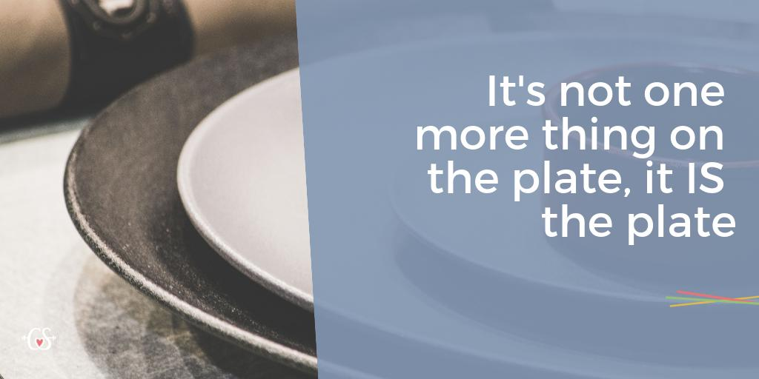
Emotions Matter Mindset
SEL…

Slide 12

The RULER Approach & Skills

Slide 13
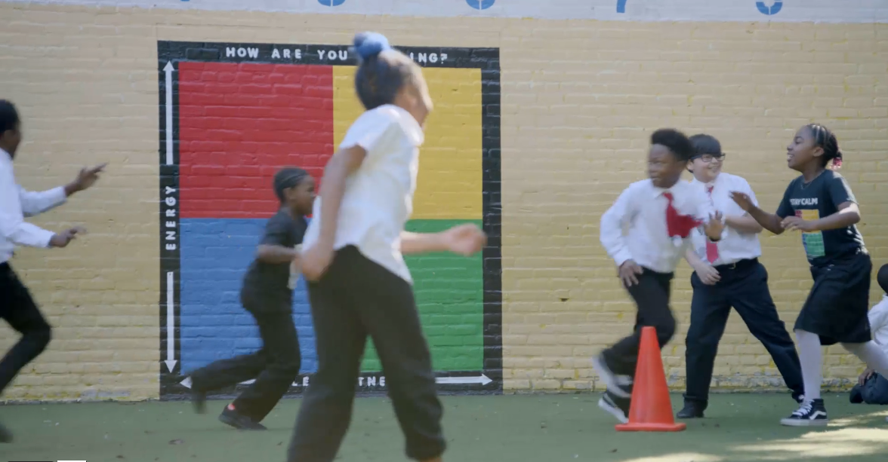
The RULER Approach
https://www.rulerapproach.org/

Slide 14
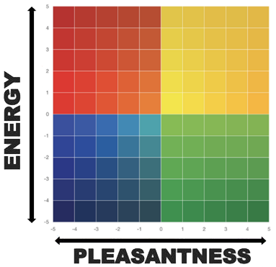
The Mood Meter
The Mood Meter is a tool that can help us build all five of the RULER skills. We can use the Mood Meter to recognize, understand, and label emotions, which builds our self- and social-awareness.
The horizontal x-axis measures pleasantness
The vertical y-axis measures energy

Slide 15
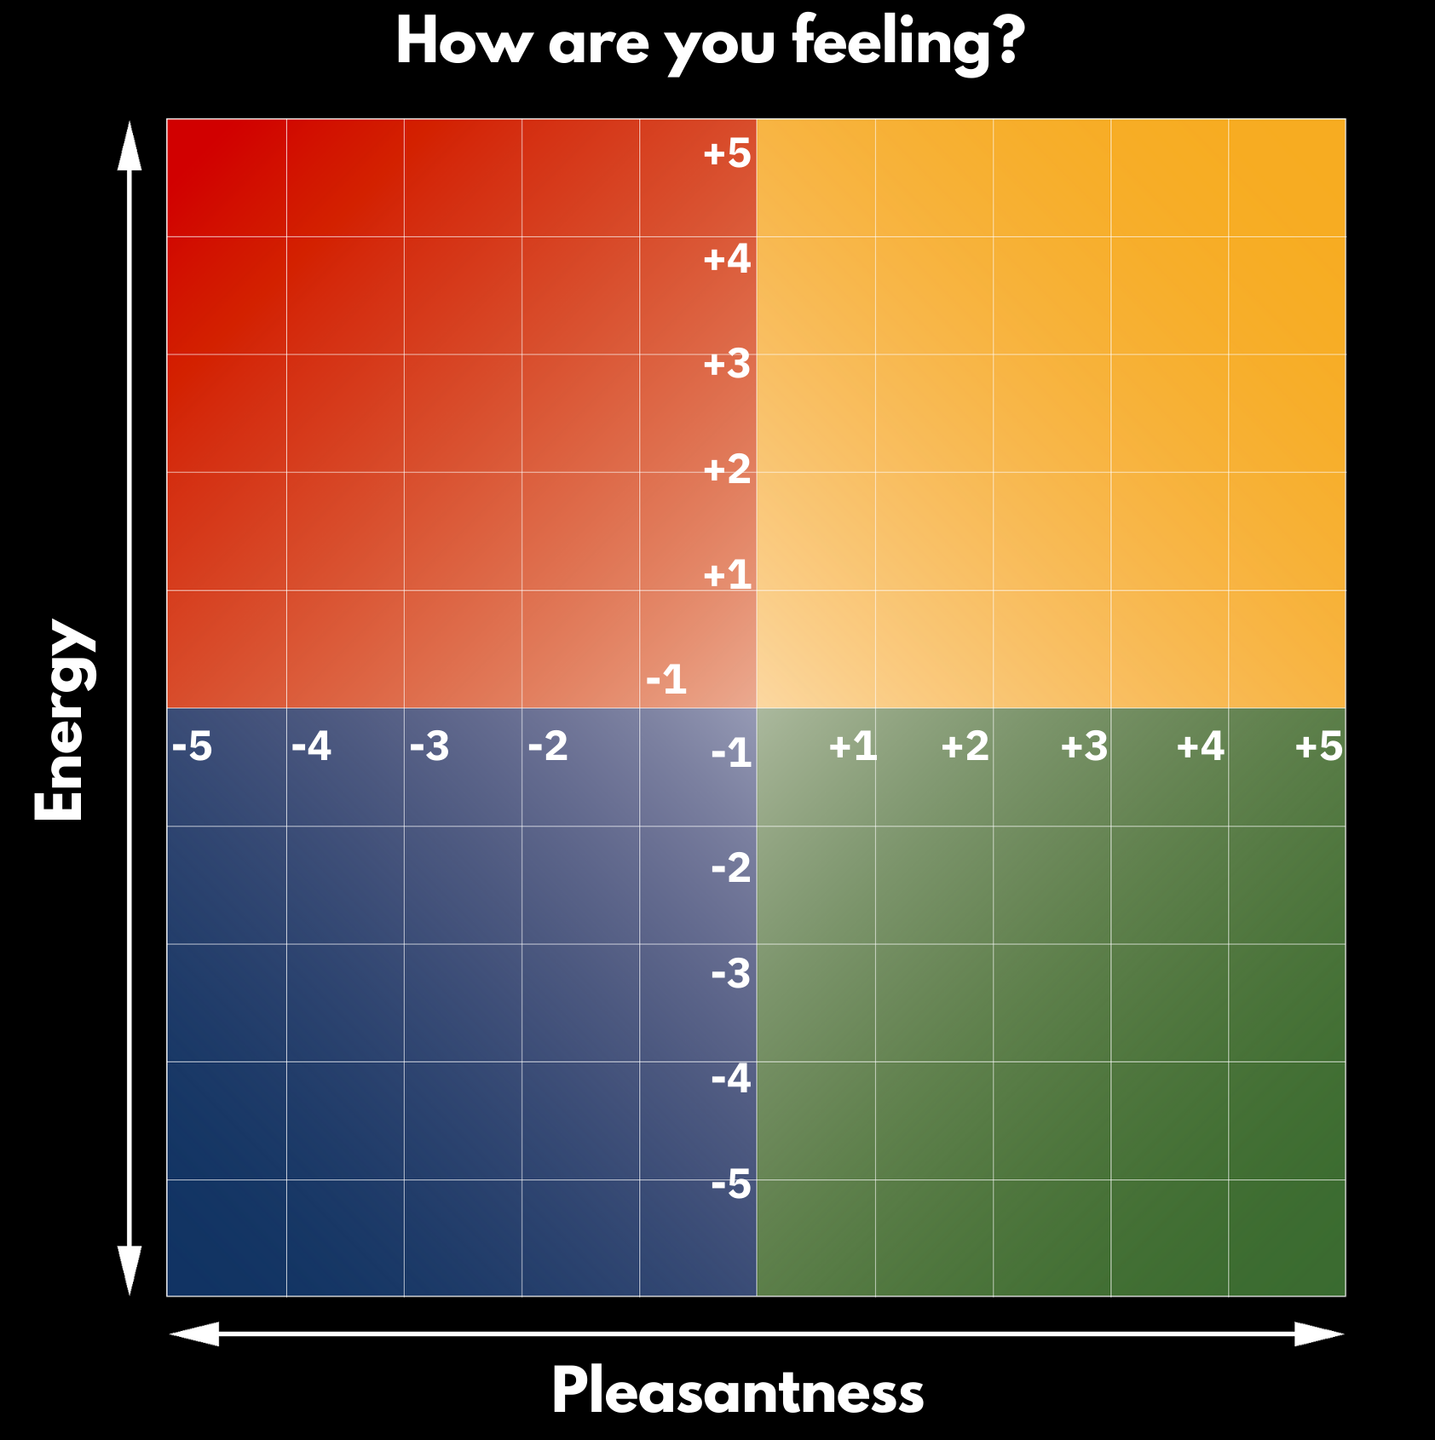




The Mood Meter
The x- and y-axes intersect to form four quadrants.
Unpleasant, high energy (red) emotions are found in the upper left quadrant. Emotions like anxiety, frustration, anger, and fear reside in this quadrant.
Unpleasant, low energy (blue) emotions are found in the lower left quadrant. Disappointment, sadness, discouragement, and loneliness can be found in the blue quadrant.
Pleasant, high energy (yellow) emotions are found in the upper right quadrant. Joy, excitement, enthusiasm,
and empowerment reside in the yellow quadrant.
Pleasant, low energy (green) emotions are
found in the lower right quadrant. Emotions
like calm, relaxed, serene, and balanced
reside in this quadrant.

Slide 16
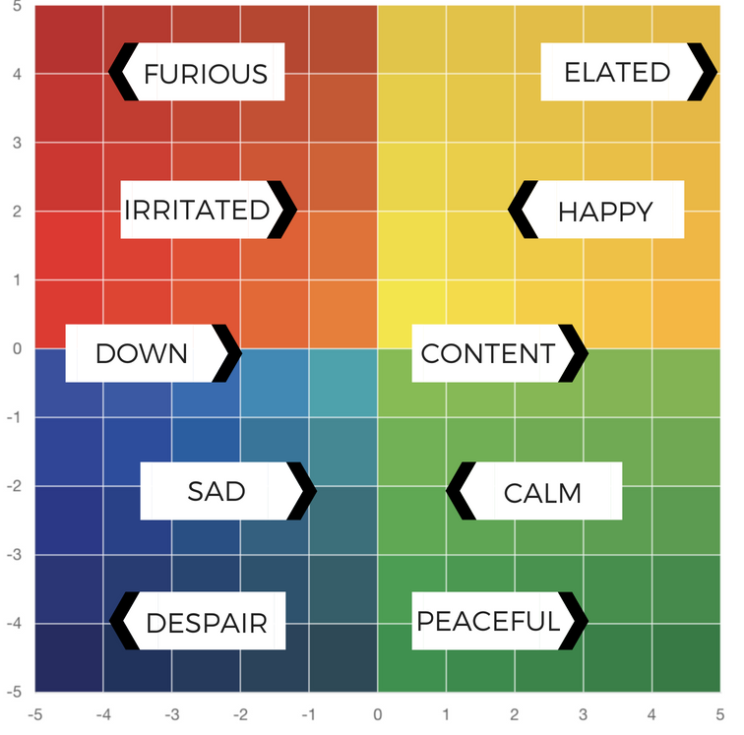
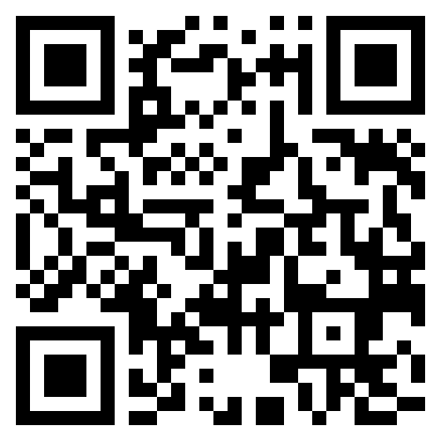
The Mood Meter
New Hire Orientation
EPS Learns
August 22, 2024
Please go to:
moodmeter.online
...and enter the group plot code:
7wx38q
Or access the QR code

Slide 17


The Mood Meter | Shifting Quadrants
https://youtu.be/428eliiE8mA?si=3xsyZAldw3upx_Fl
https://youtu.be/Sdo-K0Ln3Fc?si=yKBuwCzW8BSf3Qqk

Slide 18
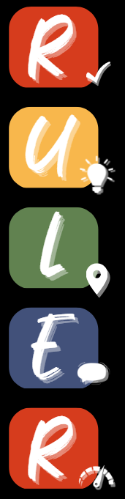
The RULER Skills
Recognizing emotions in ourselves and others
Understanding the causes and consequences of emotions
Labeling emotions accurately
Expressing emotions appropriately
Regulating emotions effectively

Slide 19
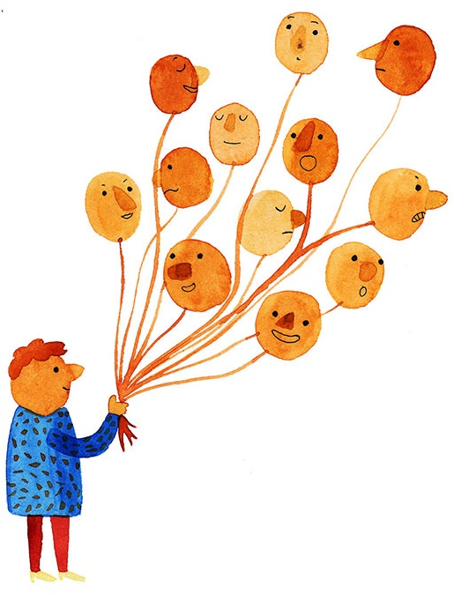
The First R of Ruler is for Recognizing Emotion
Recognizing emotion refers to identifying emotions by interpreting:
Our own thoughts and physiology (heart rate, body temperature, etc.)
Cues in ourselves and others, including:
  Facial expressions
  Vocal tones
  Body language
  Words and behavior
Practicing this skill builds our self-awareness. When we pay attention to our own thoughts and behavior, we begin to know and understand ourselves better.
Recognizing emotions also enhances our social awareness. When we look for clues in others’ faces, voices, bodies, and behavior, we can better understand how they may be feeling. We can use this information to guide how we respond to them.

Slide 20

The U of RULER is Understanding Emotions
This skill involves understanding both the causes and consequences of emotions, including their effects on:
      Thinking
      Learning
      Decisions
      Behavior
In other words, understanding emotion involves
asking ourselves why we feel the way we do and
what happens when we feel different emotions.

Slide 21

The L in RULER is for Labeling Emotions
Labeling emotion involves having and using a nuanced vocabulary to describe the full range of emotions.
When we give our feelings a specific label, we create a mental picture of what each emotion looks like so that we can identify it in ourselves and others.
Labeling also helps us to effectively communicate our needs and to identify the best ways to manage our emotions.
Angry? Sad? Disappointed? Embarrassed? Frustrated? Fatigued? Stunned? Discouraged?

Slide 22

Emotional Vocabulary

Slide 23
Nuances of Labeling
Anxiety = Uncertainty about the future
Fear = Feeling as if there is impending danger
Stress = Too many demands, not enough resources
Pressure = Something at stake is dependent upon your behavior
Frustration = Feeling like you can't overcome an obstacle
Overwhelm = Overcome by emotion
Anxiety
Fear
Stress
Pressure
Frustration
Overwhelm

Slide 24
Nuances of Labeling
Envy
Jealousy
Envy = wanting something that someone else has
Jealousy = feeling threatened about the possible loss of a relationship or affection/attention to someone else
Where jealousy takes three parties to happen, envy only takes two.

Slide 25


Nuances of Labeling
Embarrassment & Humiliation
Both involve discomfort when an aspect of
ourselves is observed/revealed that we think is likely to undermine the image of ourselves that we seek to project to others
We typically bring embarrassment upon ourselves
(and can often be humorous), but humiliation is
something that is brought upon us by others
(and is perceived as unjustified).

Slide 26
Nuances of Labeling
Emba= feeling remorse or responsible for something you've done wrong or perceived you did wrong
Shame = Feeling that you are bad, worthy of contempt, or inadequate as a person
Guilt says, “I did something bad.” Shame says, “I am bad.”
Guilt
Shame

Slide 27


The Power of Labeling
Labeling our emotions with precise words does four main things:
It legitimizes and organizes our experiences
It helps others to meet our needs
Similarly, it helps us meet the needs of others
Finally, it connects us to the rest of the world
The words give us each a story to tell.

Slide 28

The E of RULER is for Expressing Emotion
The skill of expressing emotion involves knowing how to show our emotions in ways that take into consideration norms and context. In other words, it’s really about the “how” and the “when” we express our emotions.
Three areas to consider when we think about
expressing emotions are:
  Individual differences
  Culture
  Social norms

Slide 29
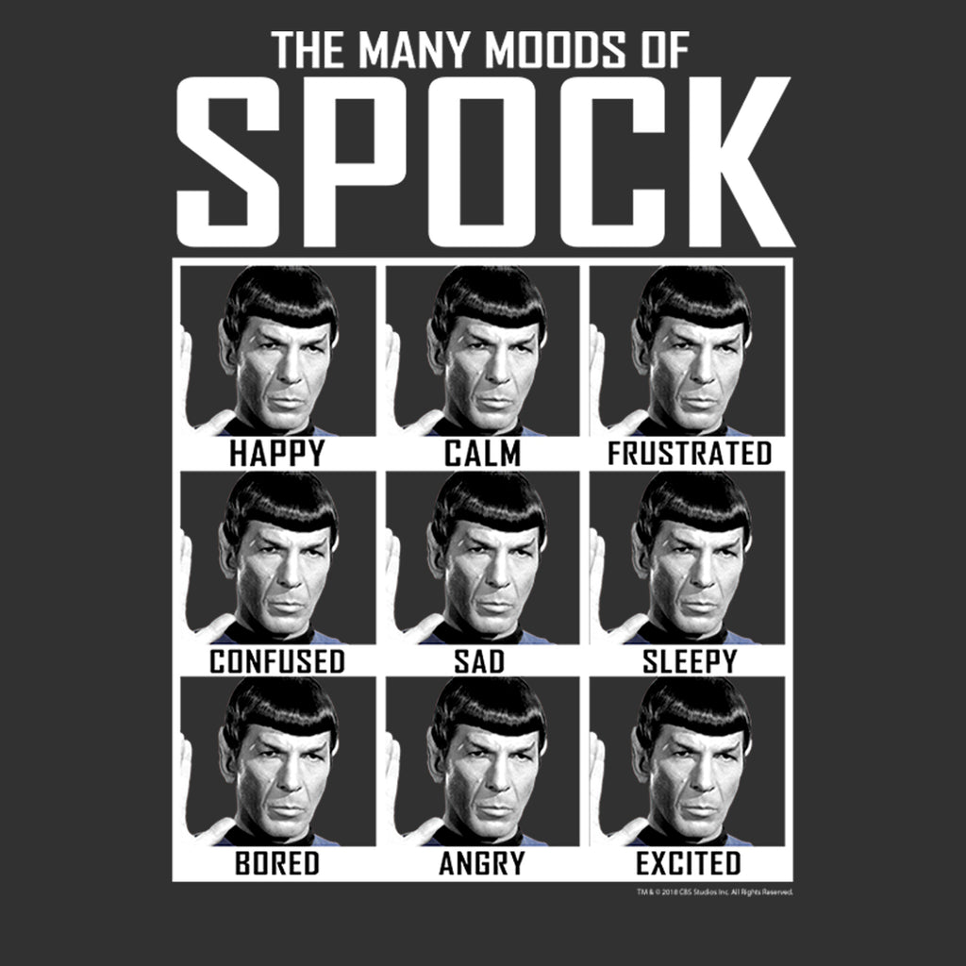
The E of RULER is for Expressing Emotion

Slide 30
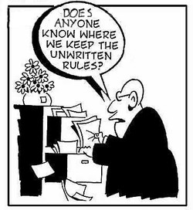
The E of RULER is for Expressing Emotion
We may mask our expressions to fit the “norms” of our environments. These norms are known as display rules.

Slide 31
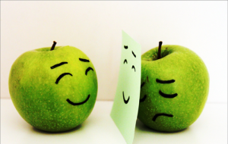
The E of RULER is for Expressing Emotion
There often is a discrepancy between how we feel and what we display.
The work we do to conform how we express our emotions to the norms of our environments is called emotional labor.
  Emotional labor is unavoidable. However, it can be helpful in many situations, like expending effort to remain calm and cooperative when speaking with someone who is angry.
  Still, too much emotional labor can result in burnout, decreased job and life satisfaction, and health problems. This is why it’s important to keep it in check!

Slide 32

The last R of RULER is for Regulating emotion
Regulating emotion is managing our emotions by developing thought or action strategies to reach a specific emotional goal.
Our emotional goals generally fall into the following areas, which we can remember with the acronym, PRIME:
  Prevent an unwanted emotion – like anxiety before a test
  Reduce an unwanted emotion – like anger when we are in an escalated conversation with someone
  Initiate a new emotion – like inspiration to be creative
  Maintain an existing emotion – like remaining calm in a stressful situation
  Enhance or increase a desirable emotion – like joy while at a celebration

Slide 33
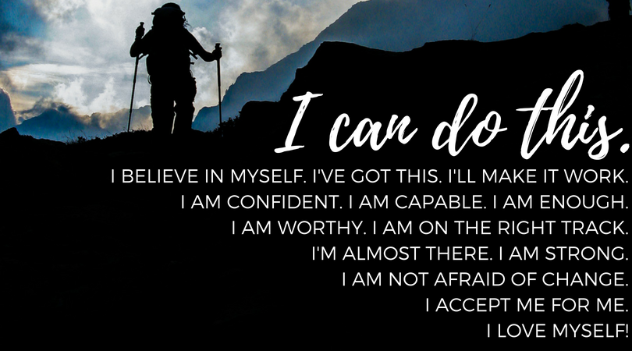
The last R of RULER is for Regulating emotion
Once we have selected a PRIME goal, we can choose strategies that will help us reach that goal.
Regulation strategies include:
THOUGHT STRATEGIES (things we think about)
ACTION STRATEGIES (things we can do)

Slide 34
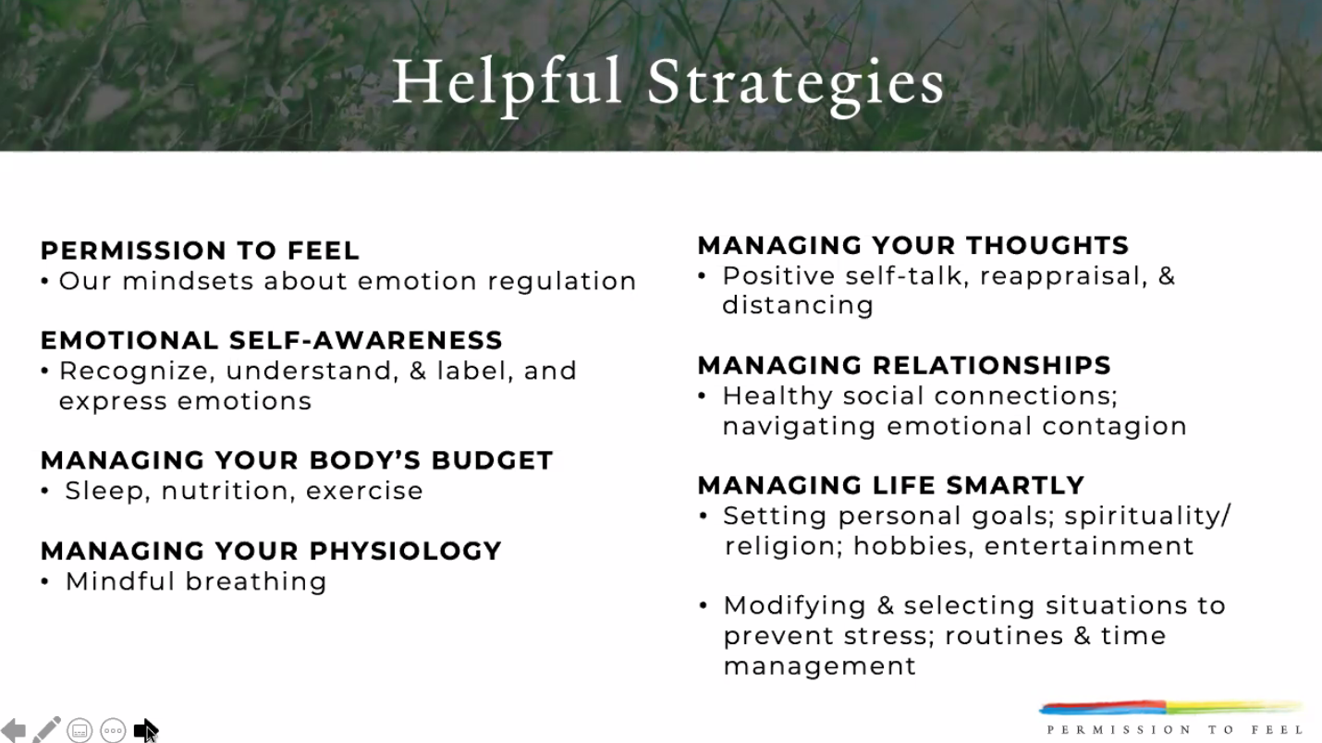
Thought & Action Strategies

Slide 35
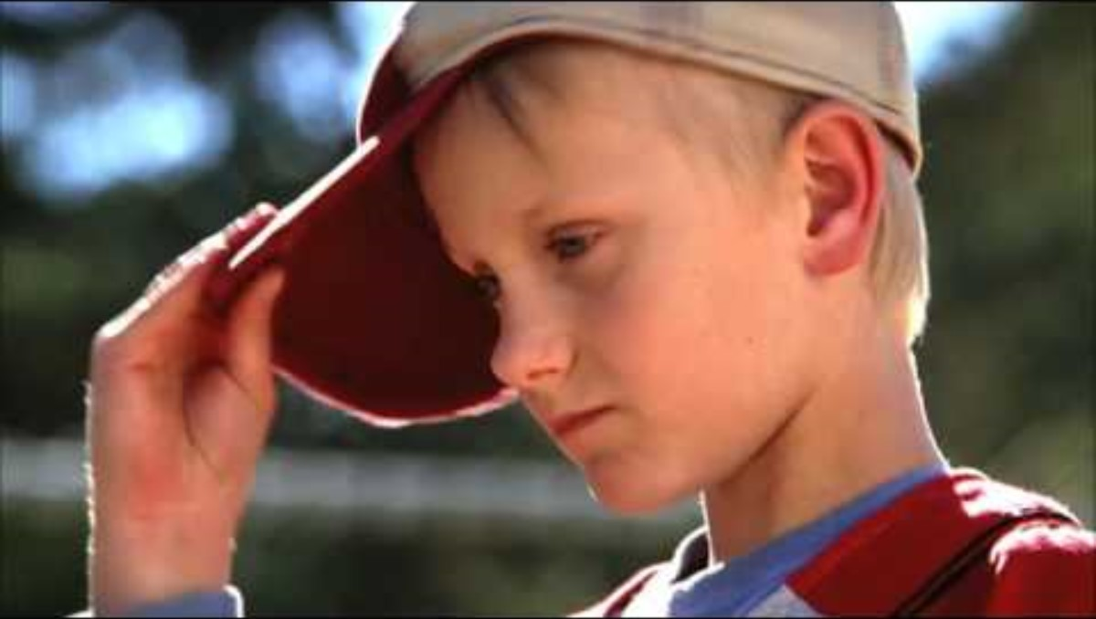
Thought Strategy | Self-Talk

Slide 36

Action Strategy | Breathing

Slide 37
Barriers to Emotion Regulation
Personal
Fatigue (e.g., emotional labor)
Stress (about everything)
High expectations of others
A lack of trust
Need for control
Prior baggage
No education in
emotional intelligence
Relational
Other's impatience (with me)
Other's negativity
Lack of support from others
Feeling disrespected
Environmental
Work/home demands & struggles
Economics
Unpredictability (COVID)
Societal division/War
Feeling confined
Time in the day
Cultural
Differences in display rules
Family expectations
Unwritten rules for expression
The values connected to certain emotions

Slide 38

Emotion Scientists vs. Emotion Judges
Emotion scientists are empathic, inquisitive, active listeners, contemplative, and focus on the facts.
Emotion judges are critical, reactionary, inflexible, and make assumptions.
  Recognizing? → The emotion judge makes quicks assumptions and may misdiagnose emotion by observing behavior
  Understanding? → The emotion scientist asks good questions
  Labeling? → The emotion judge just labels what others are feeling or even attributes emotions to people’s personalities
  Expressing? → The emotion judge makes assumptions
  about why people are expressing emotions the way
  they do, e.g., “She’s not sharing because she’s
  antagonistic”
  Regulating? → The emotion scientist explores new
  regulation strategies through trial and error

Slide 39
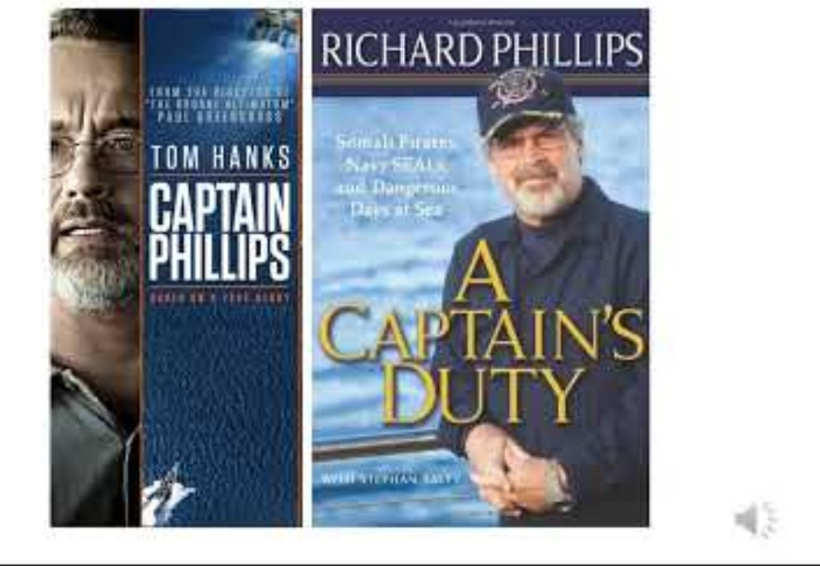
Addressing Misconceptions

Slide 40
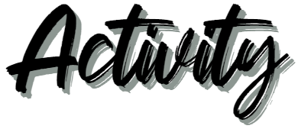

Addressing Misconceptions
LAYUP DRILL: Pair up with someone and face each other. 1st person will make the statement, 2nd person will respond (30 seconds). Then switch roles.
What would you say to someone who says,
I don’t have time to teach both SEL and [content type].
To survive in this world, kids need to learn toughness. Teaching them SEL will just make them soft.

Slide 41
The RULER Skills
Recognizing emotions in ourselves and others
Understanding the causes and consequences of emotions
Labeling emotions accurately
Expressing emotions appropriately
Regulating emotions effectively

Slide 42
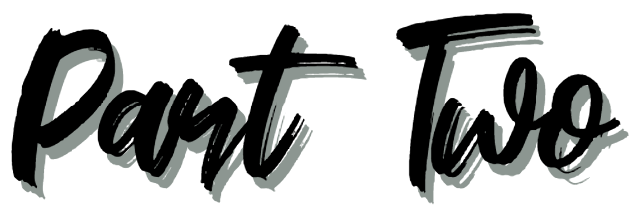
The RULER Anchor Tools

Slide 43
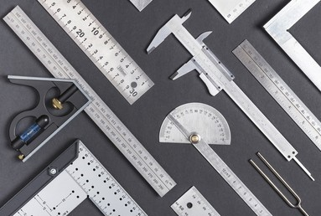
The RULER Anchor Tools
The RULER approach can be put into practice by using the four foundational anchor tools, which focus on developing emotional intelligence and creating positive emotional climates at home and at school.

Slide 44


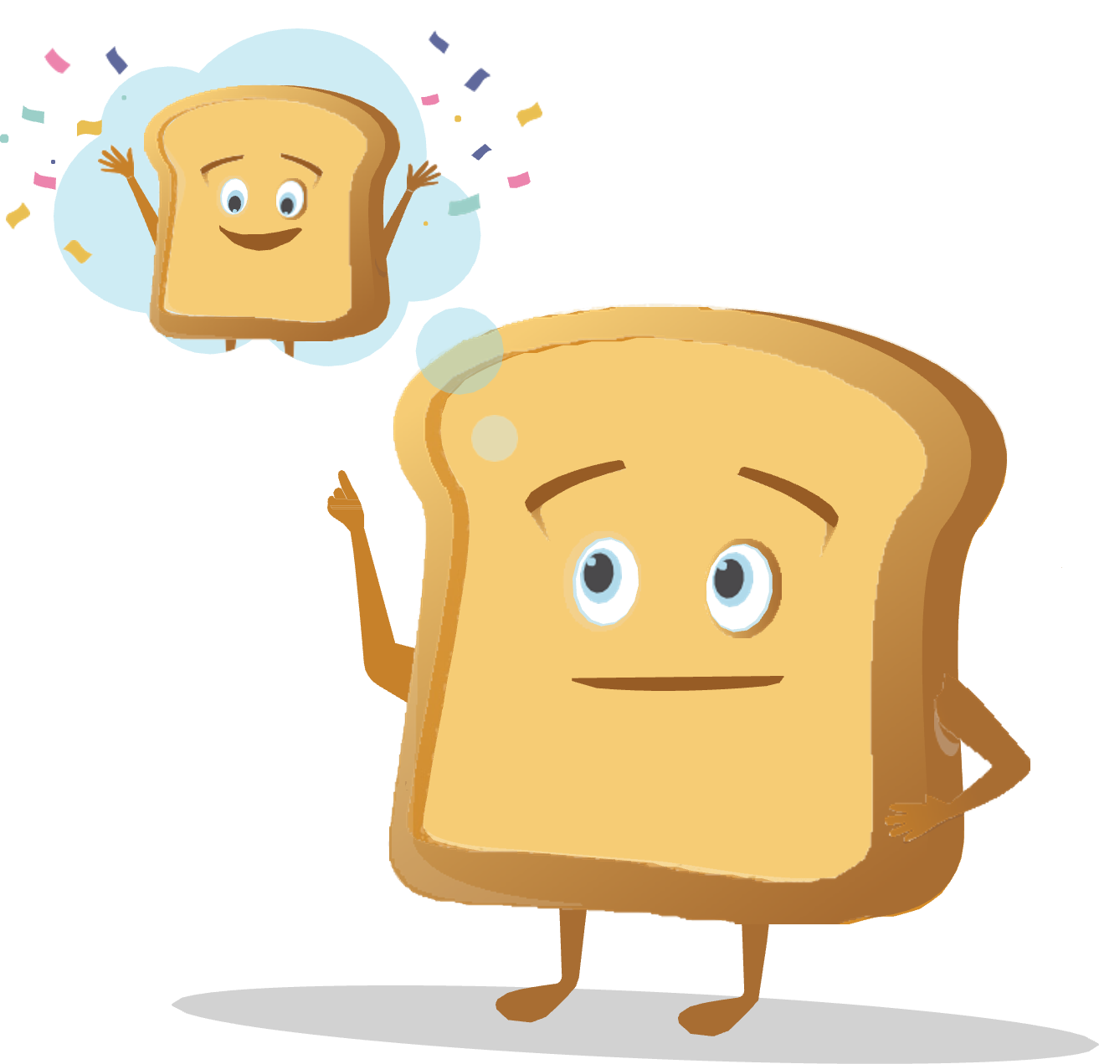

The RULER Anchor Tools
The Charter represents agreed-upon norms for how everyone in a school, classroom, or other environment wants to feel. The Charter also explains what needs to happen or change to build and sustain positive emotional climates.
The Mood Meter is a visual guide to help individuals accurately analyze and “plot” their feelings. The Mood Meter develops skills in recognizing and labeling emotions, which can be further developed into understanding, expressing, and regulating emotions.
The Meta-Moment is a process for responding to emotional triggers in ways that align with one’s best self. The goal is to shift from automatic, unhelpful reactions to strategic, effective responses.
The Blueprint is a problem-solving tool for working with interpersonal conflicts. The Blueprint can be used independently or collaboratively to enhance empathy and identify effective solutions for past, real-time, or anticipated conflicts.

Slide 45
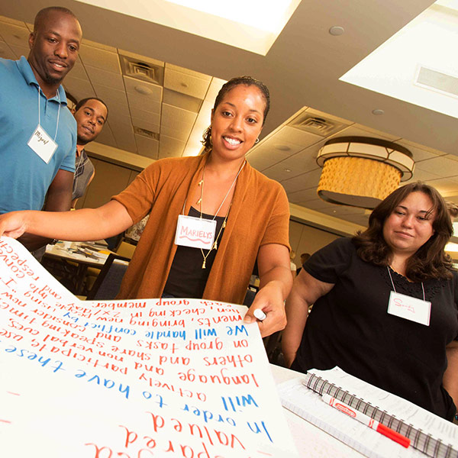
The Charter
There is a clear gap between how school community members feel and how they want to feel. This presents us with an opportunity–a call to action to develop plans for enhancing emotional climates.
This is where the Charter comes in. The Charter allows everyone in a school community the chance to articulate how they want to feel at school, then work together to agree upon behaviors that support those feelings. As a group, the school community members decide on what needs to happen or change for those feelings to be consistently present.
All Charters are structured around two primary
questions:
  How do we want to feel?
  How will we help each other to
  experience these feelings?

Slide 46
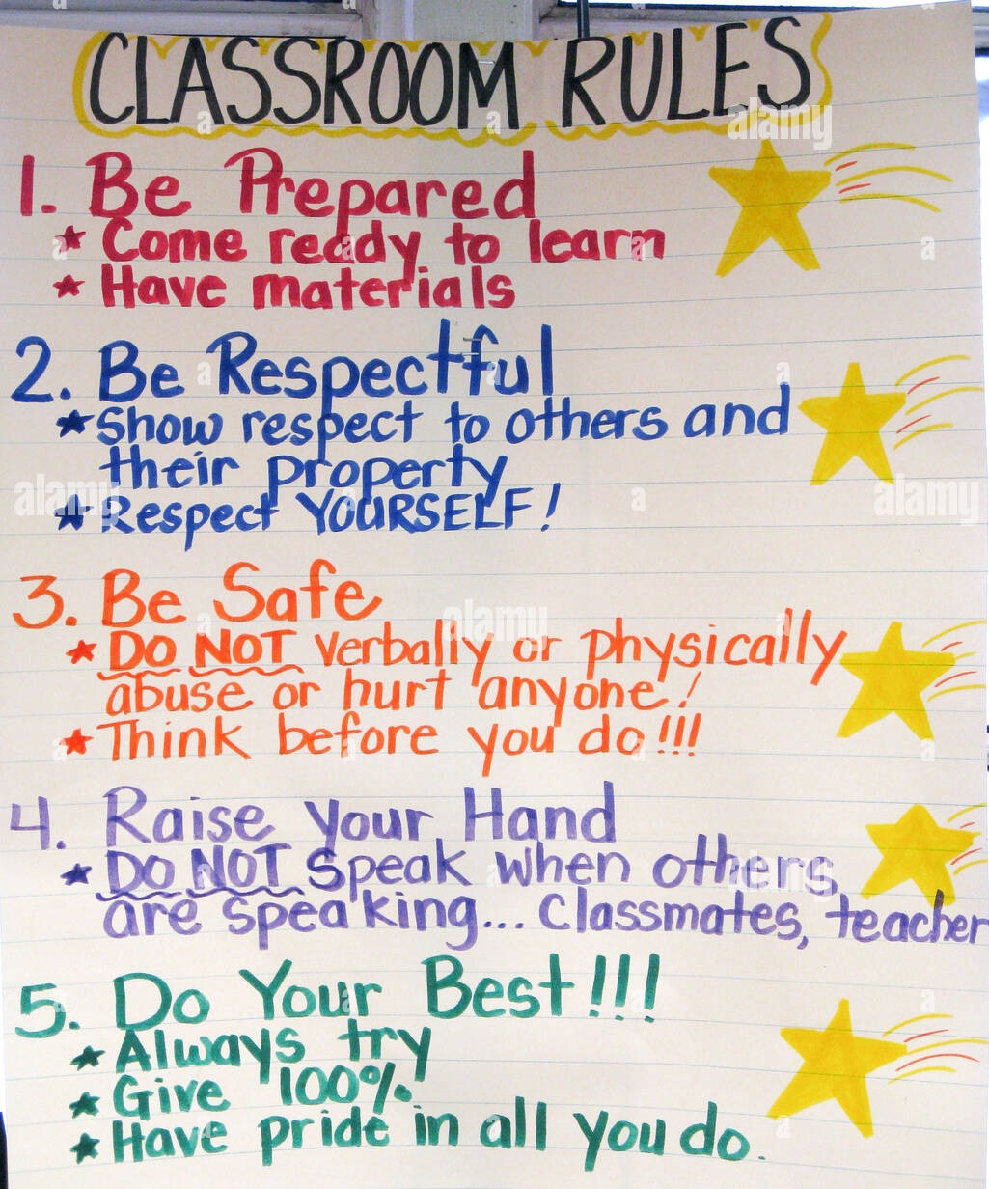
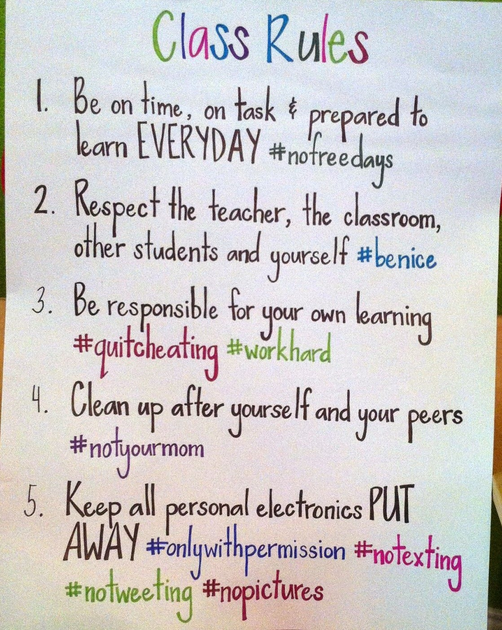
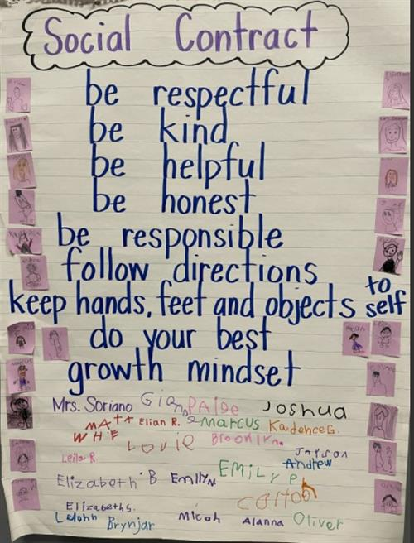
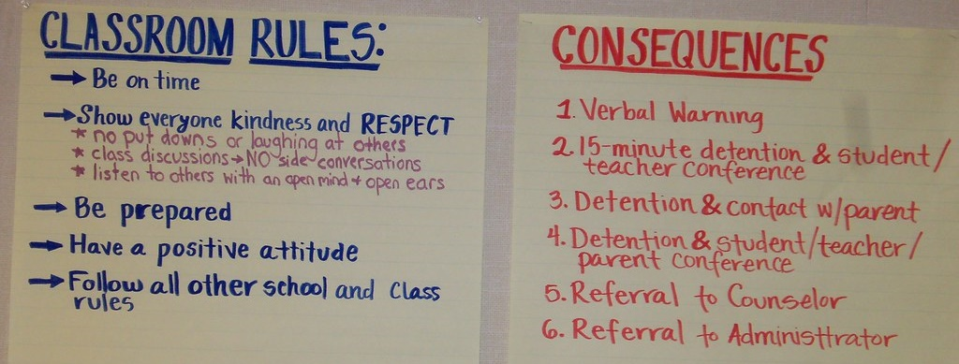
Charters vs. Classroom Rules or Social Contracts

Slide 47
The Value of a Charter
The Charter creates the WHY for the classroom rules or social contract. How we want to feel will lead into strategies that will foster and maintain them. The “rules” naturally follow – but rather than for basic compliance, they will have a deeper level of meaning and purpose.

Slide 48
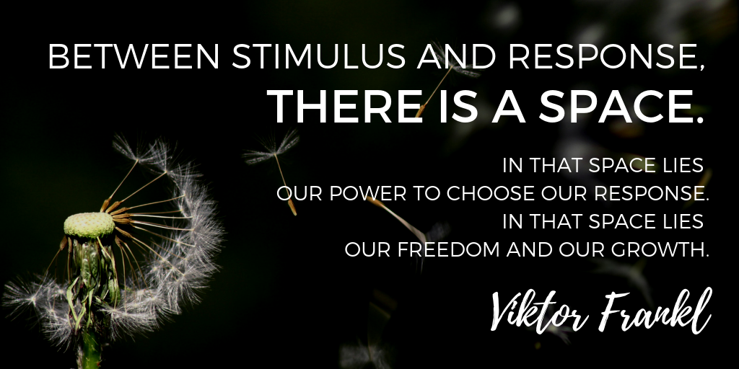
The Meta-Moment

Slide 49




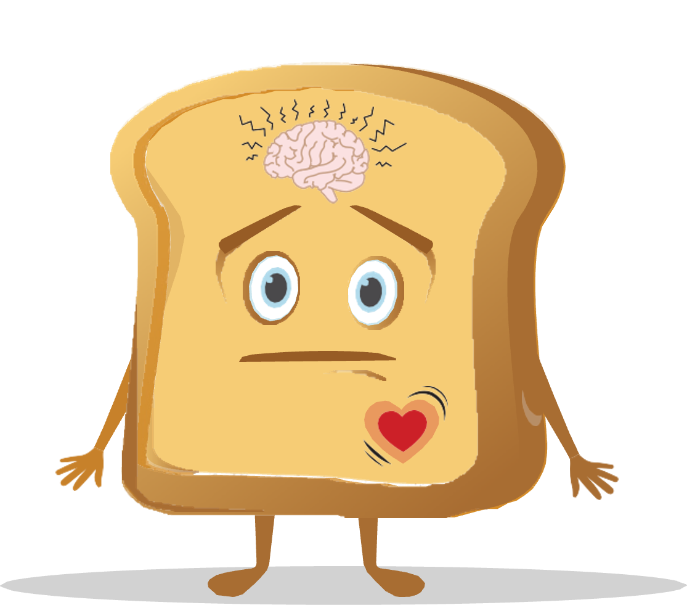
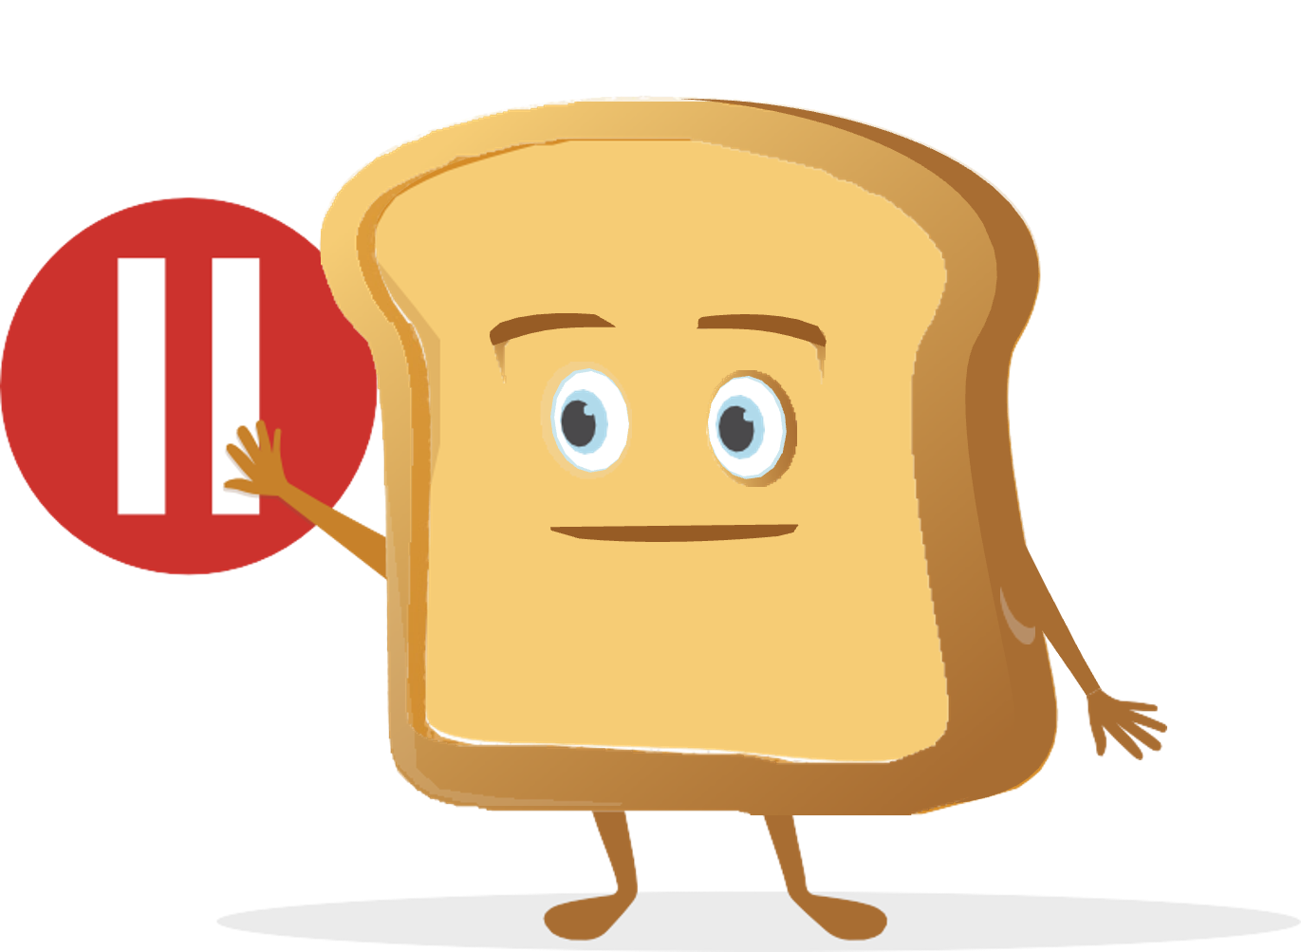
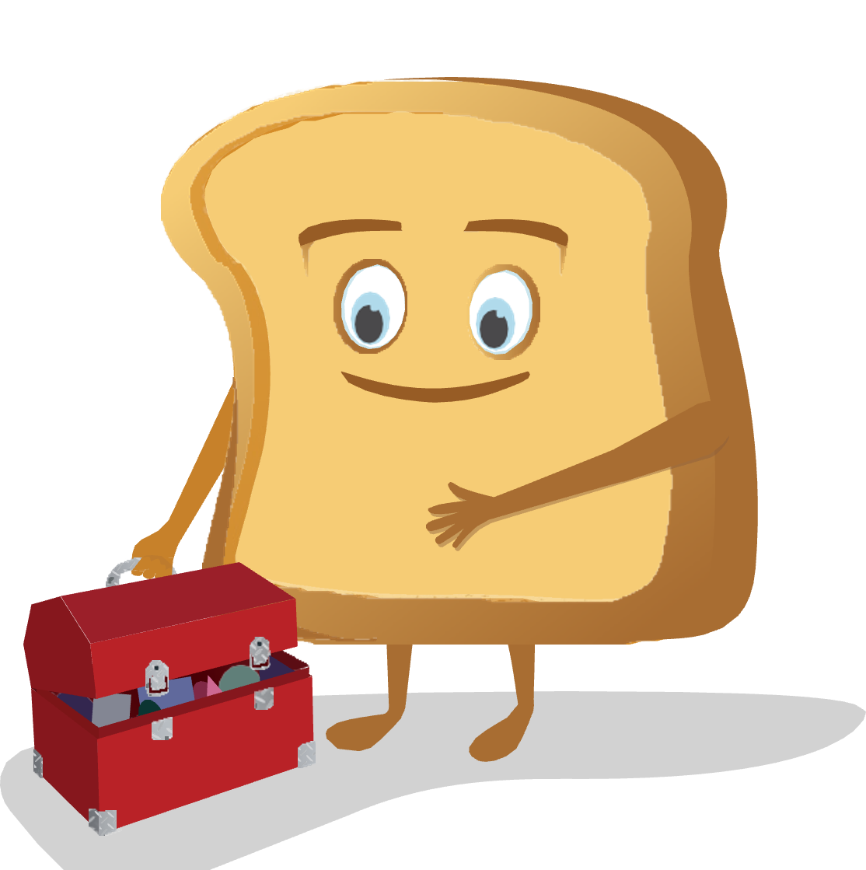
The Meta-Moment
The Meta-Moment consists of four steps:
  Sense that something has happened or changed in your environment
  Pause to de-escalate and avoid responding in an unhelpful manner
  See your best self, or visualize a positive image of yourself
  Strategize and act in a more helpful manner

Slide 50
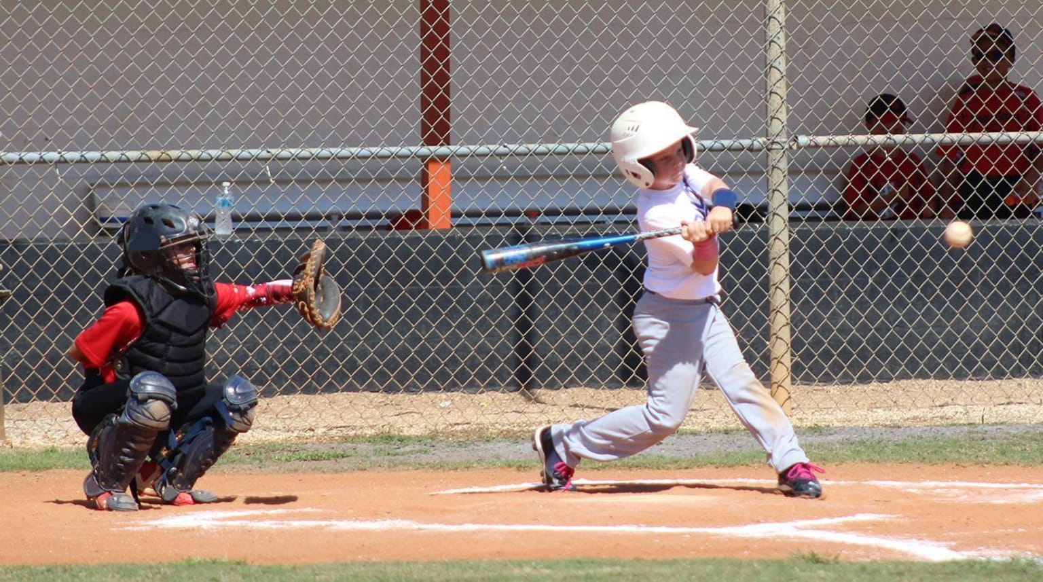

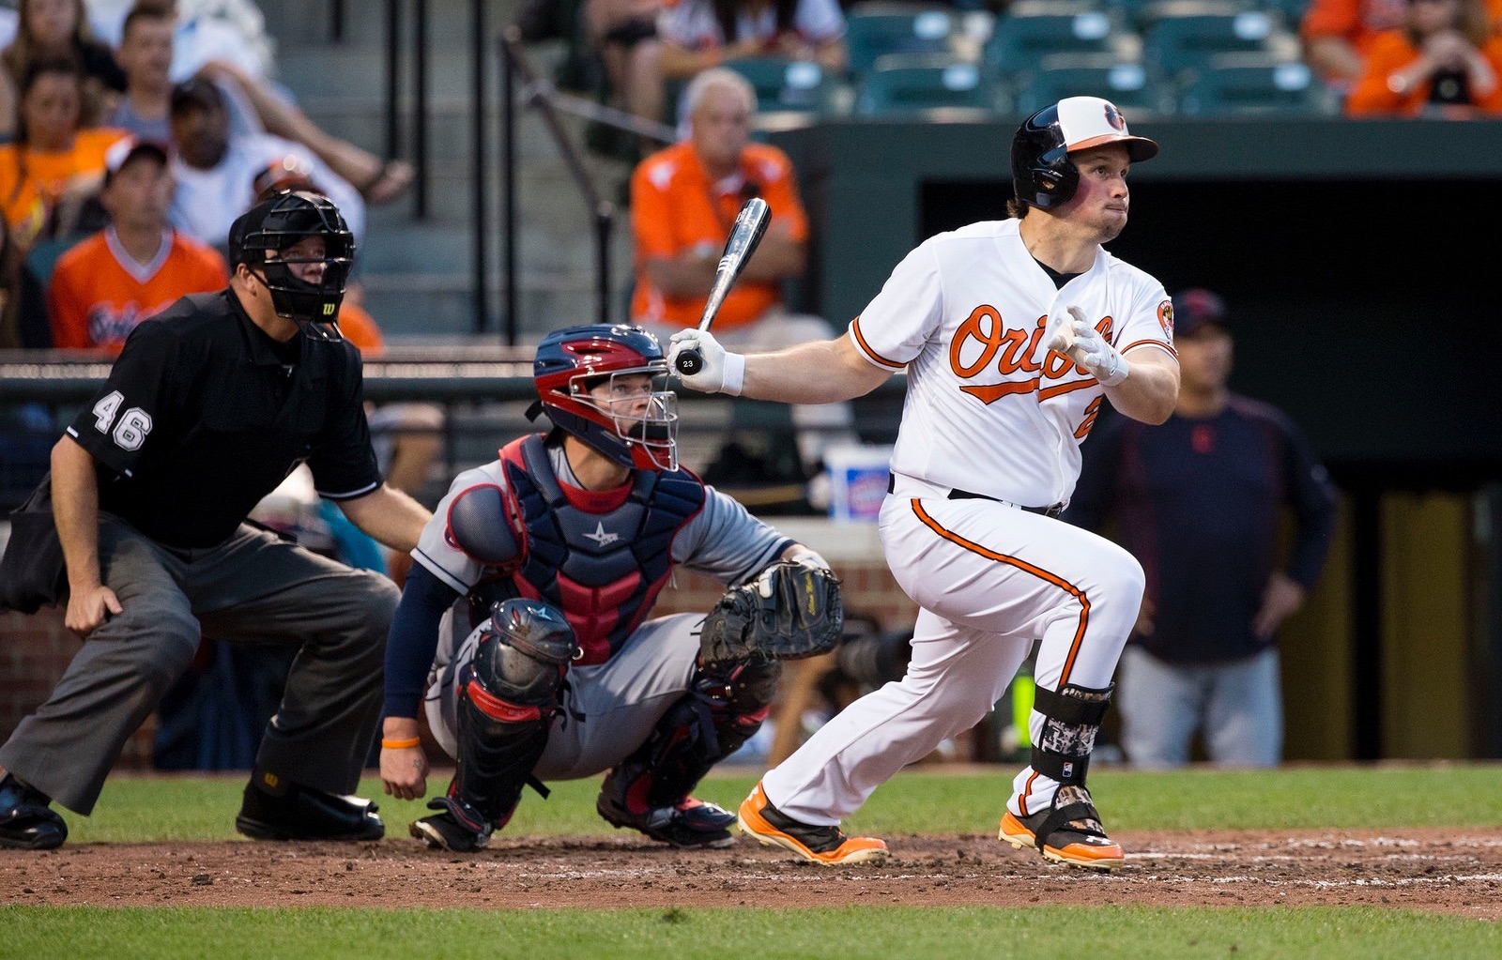
Skill-Building Considerations
Major League hitters have about 0.40 seconds reaction time to:
determine the type of pitch
determine if it's a strike or a ball
determine the speed of the pitched ball
finish the stride and get their foot down
get the bat to the ball
Must become automatic

Slide 51
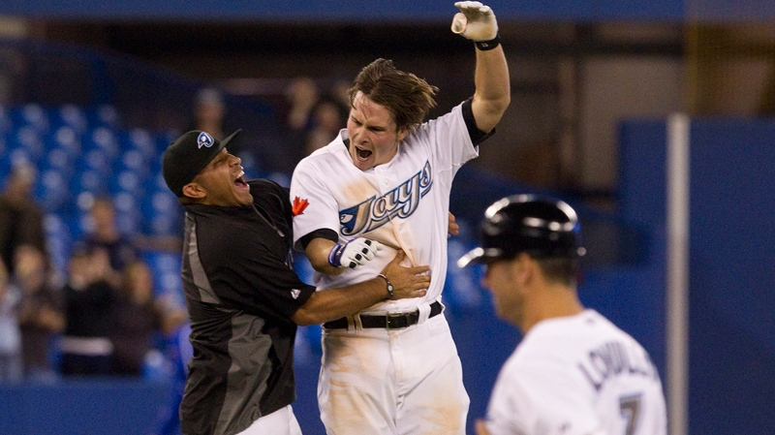


Skill-Building Considerations
If a batter fails to get on base 7 out of 10 times, he’s considered to be phenomenal!
(that’s a batting average of .300)
Perhaps we should evaluate our starting RULER success somewhere in between?
If a person is successful 97% of the time at crossing the street, that would be considered a horrible rate!

Slide 52

A Meta-Moment Story
https://youtu.be/L12b5JoRT6I

Slide 53

The Blueprint
We can tap into the restorative potential of conflict by using the fourth RULER tool: the Blueprint.
The Blueprint as a tool for reflecting on conflict and guiding conferences to resolve conflict and help to restore communities
Through answering questions about the conflict, we learn to empathize and consider the situation from the other person’s perspective.
The benefits of empathy and strategies for cultivating empathy, including active listening and paraphrasing

Slide 54
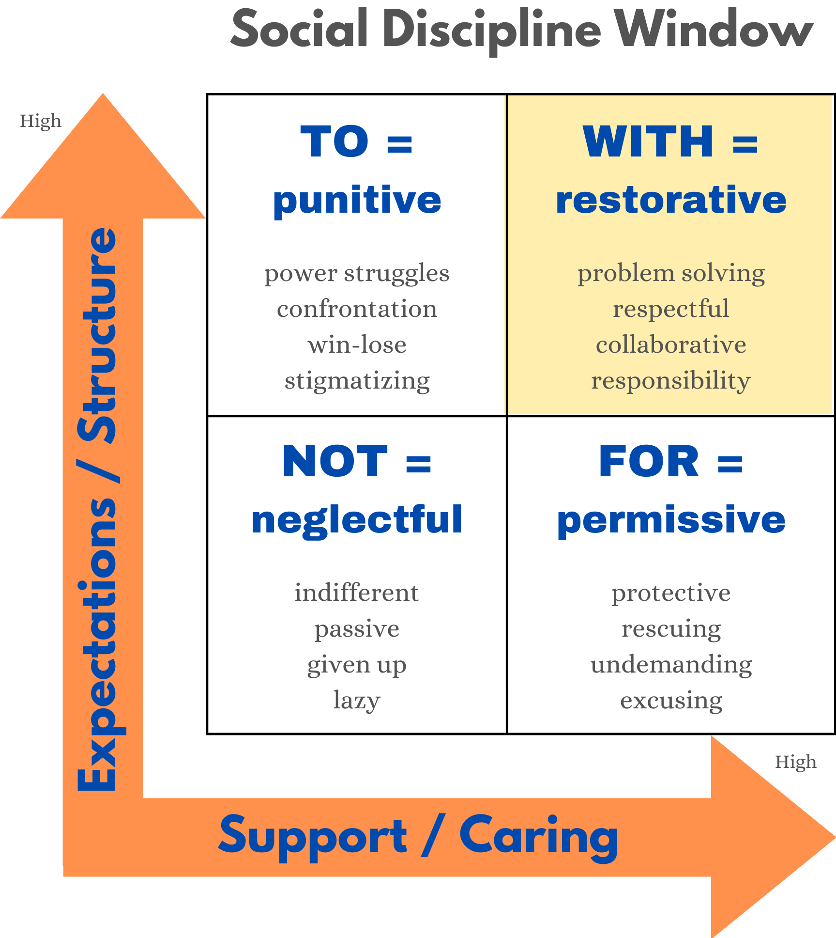
Restorative Practices

Slide 55
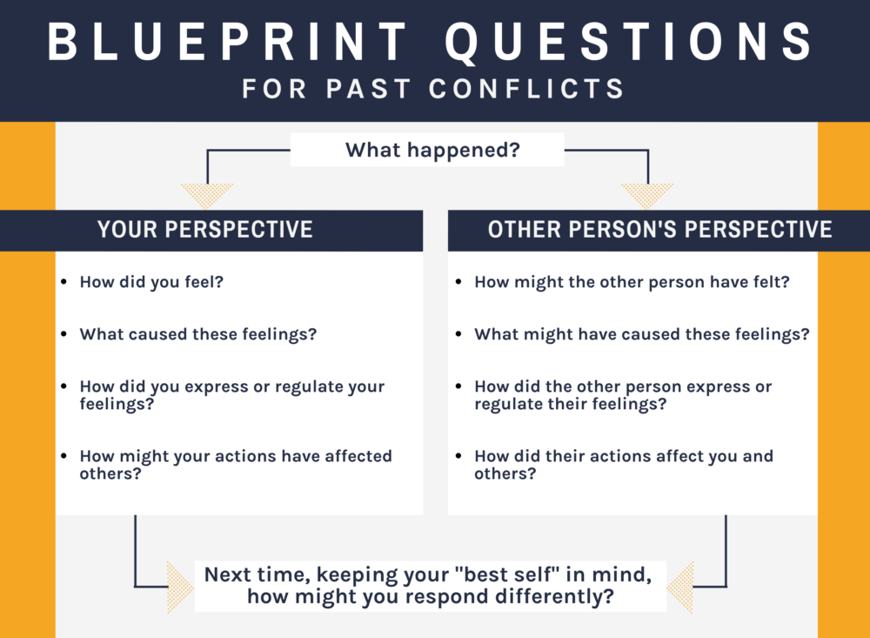
Blueprint Reflection

Slide 56
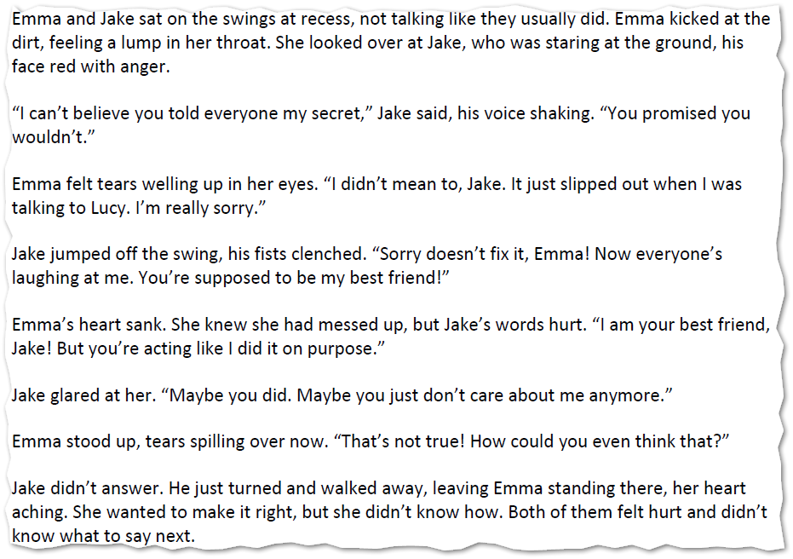
Using the Blueprint with Curriculum

Slide 57
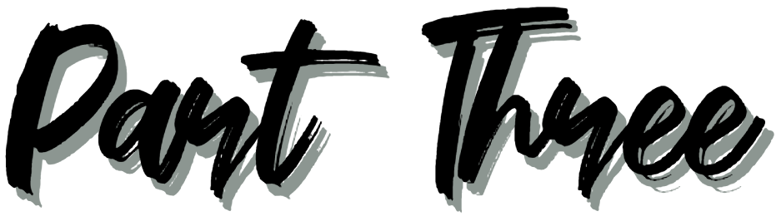
RULER Resources

Slide 58
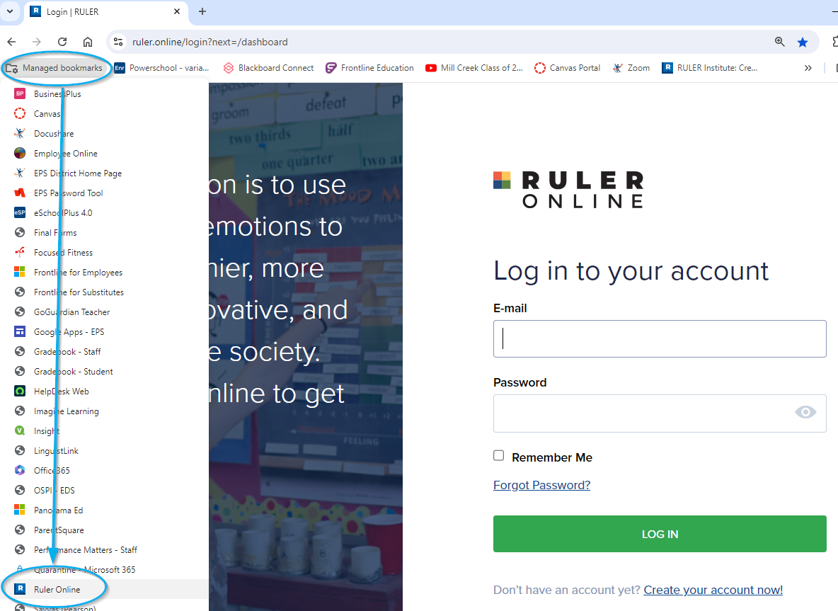
RULER Online Dashboard

Slide 59
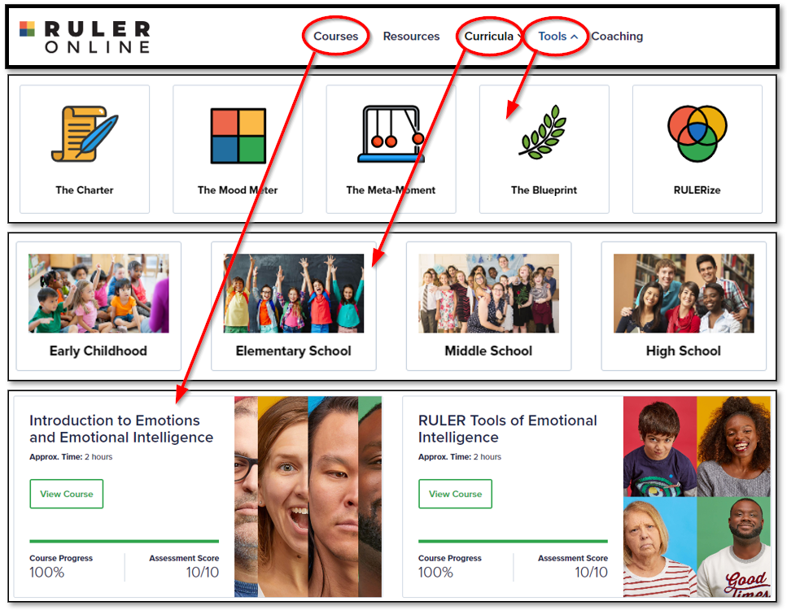
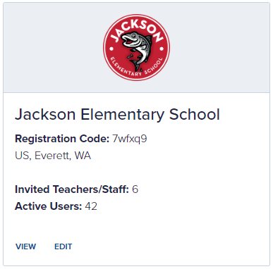
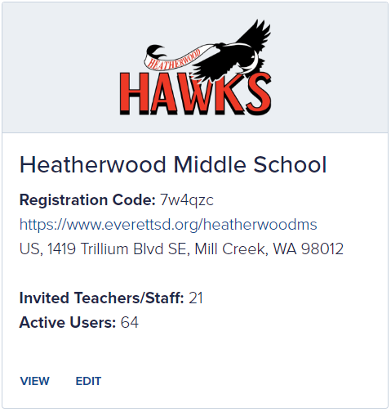
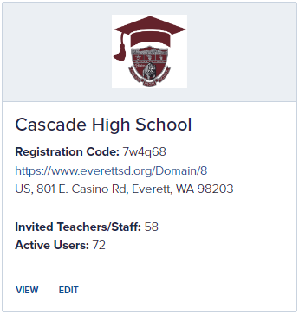
RULER Online Dashboard

Slide 60
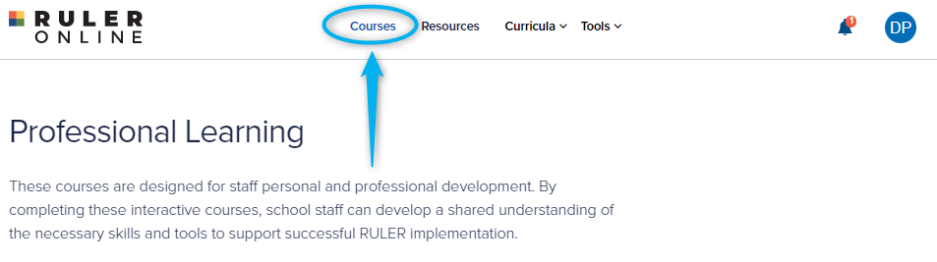
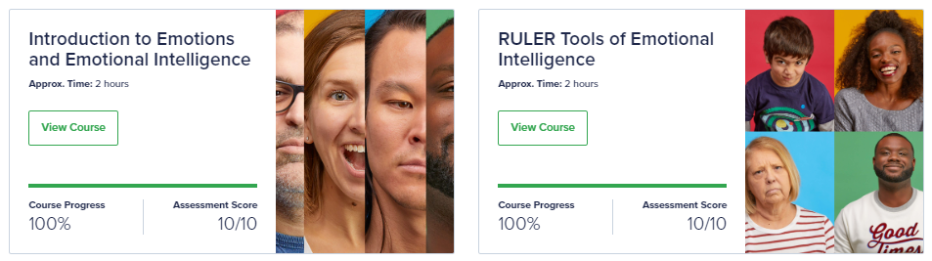
Staff Training Modules
4 clock hours are available

Slide 61


RULER Canvas Portal

Slide 62

Emotions Matter | Closing Thought
“This is important, you can do it, I will help you!”

Slide 63





